Slide 1
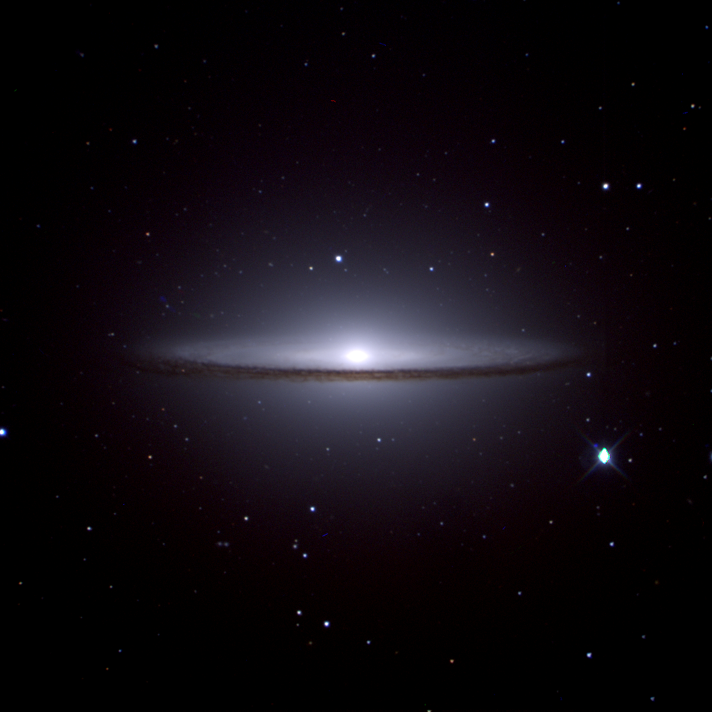
The Intelligent Observatory
Stephen Potter
South African Astronomical Observatory
University of Johannesburg

Slide 2
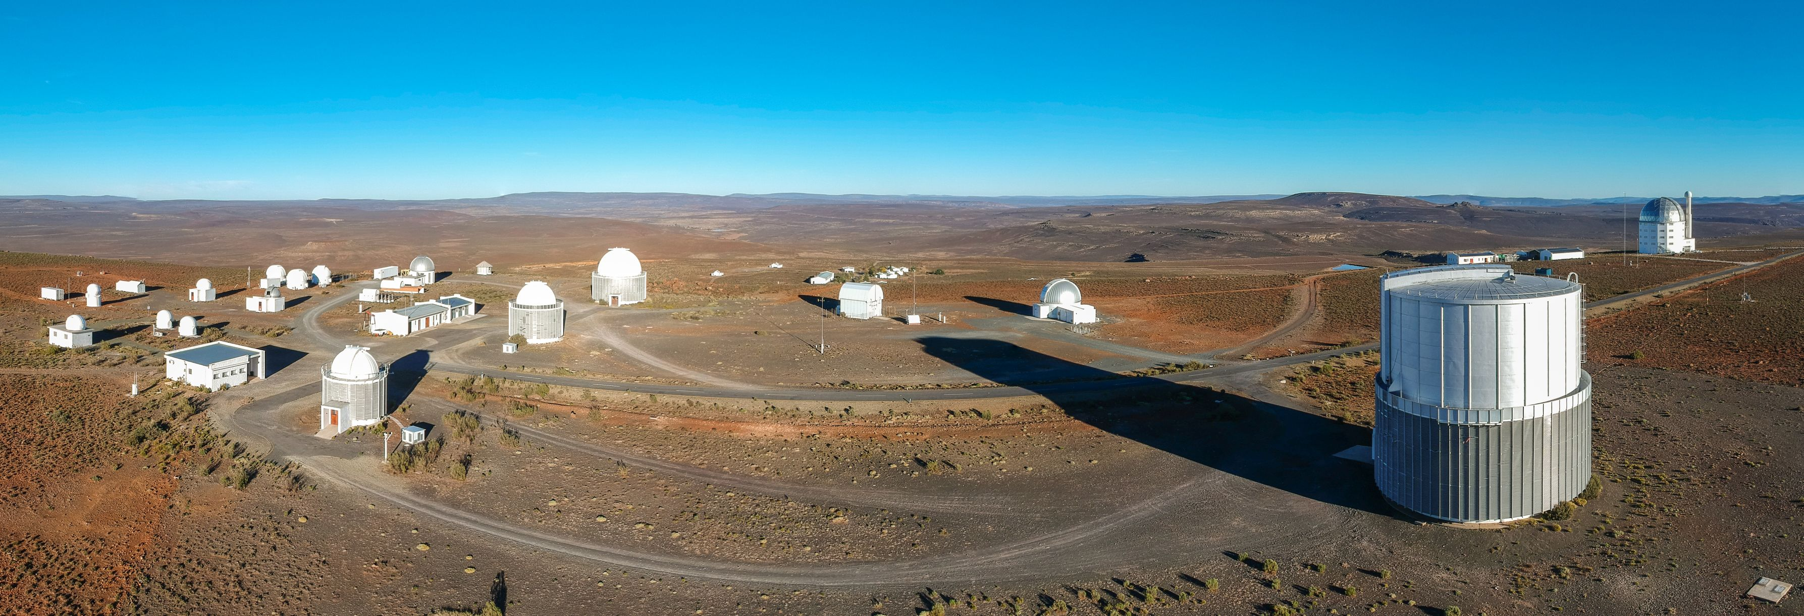

Slide 3
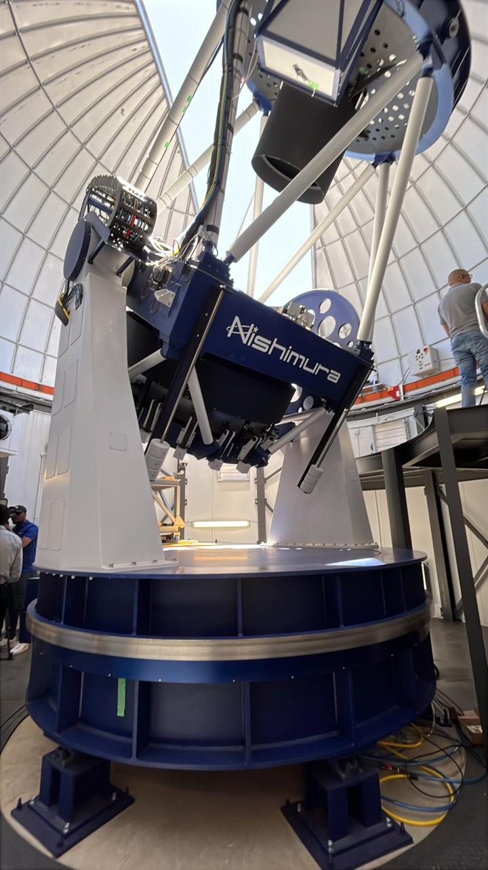
PRIME telescope
diameter = 1.8-m
prime focus detector = mosaic of 4 x H4RG-10 HgCdTe arrays with 10 micron pixels (flight spares from the WFIRST-Nancy Grace Roman Space Telescope mission)
1.3x1.3 degree FOV

Slide 4
The Intelligent Observatory (IO)
Vision #1
Submit observation requests at any time✅
Science on any time scale ✅
Observe from Sutherland, Cape Town or anywhere ✅
Observe manually, queue or service ✅
Respond to alerts, computer generated requests ✅
Automate from science idea –> data acquisition -> publication⏳
Enhance our national and international partnerships ✅
Coordinated science across telescopes in the era of multi-messenger astronomy ✅
Advance SAAO into the 4IR ⏳

Slide 5
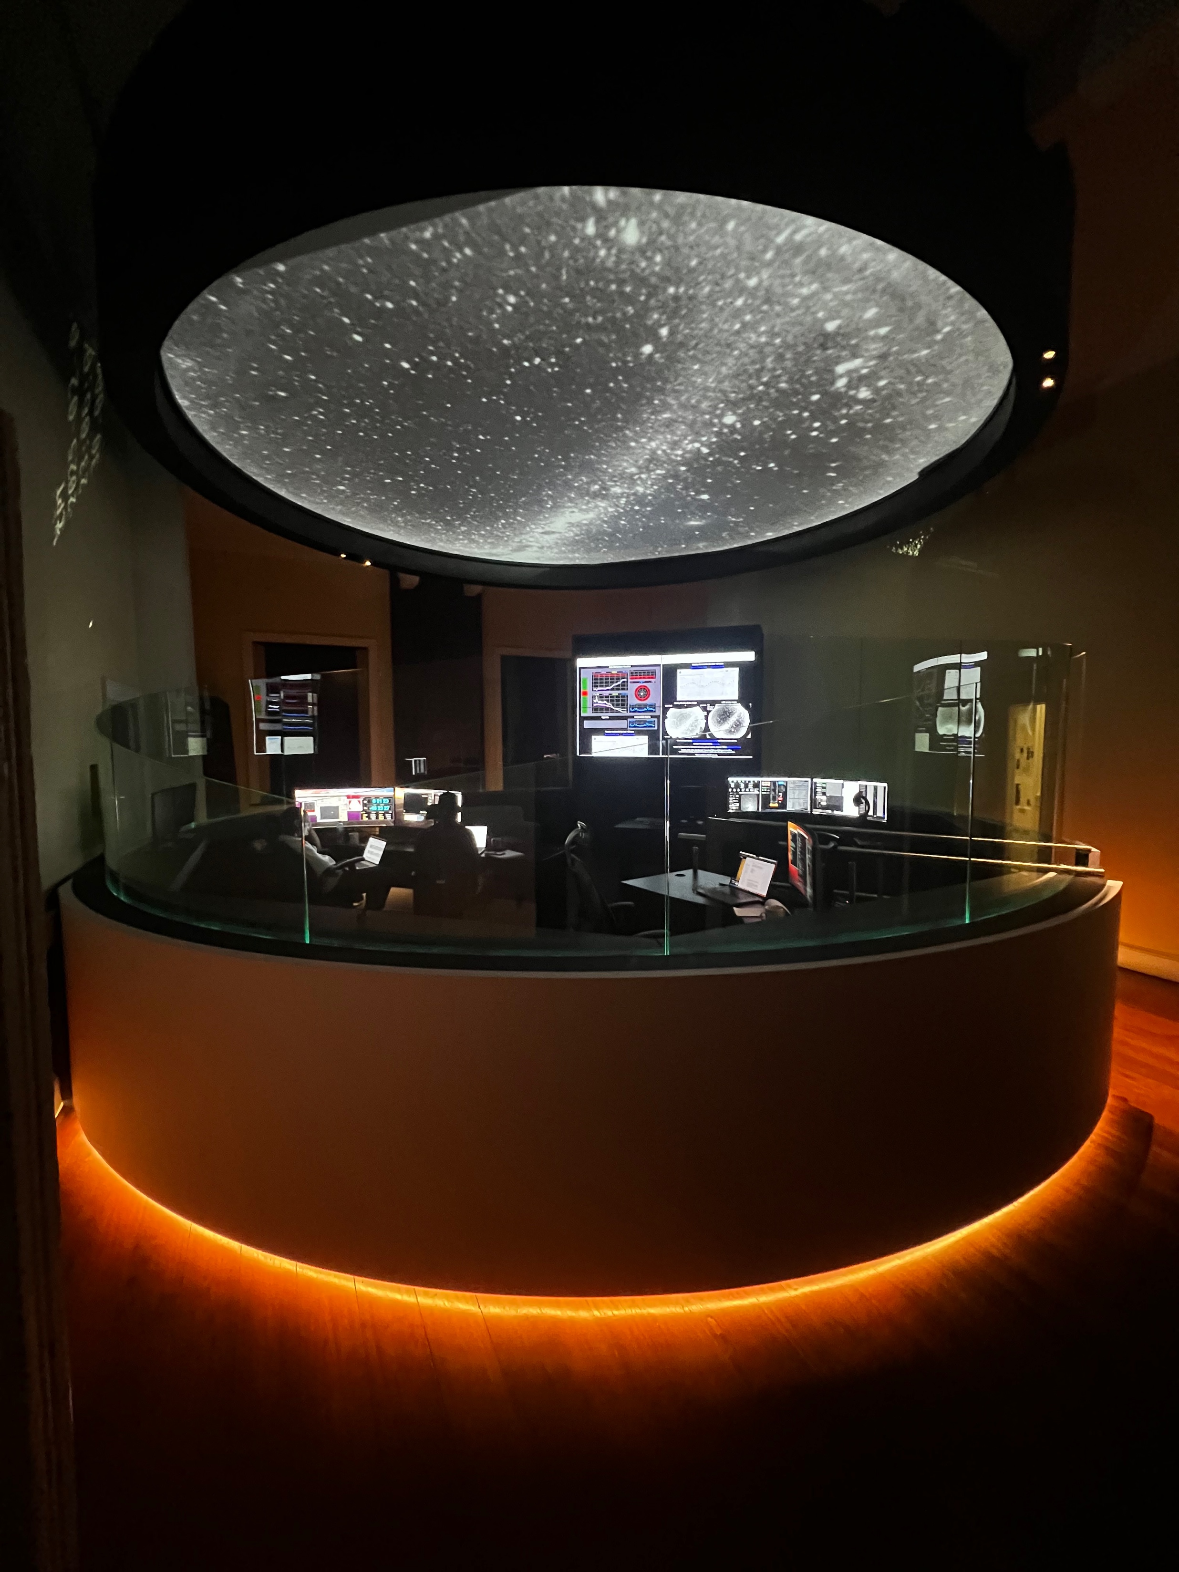
Remote Control Room in Cape Town
Designed as our flagship facility for remote operations
Immersive experience.
For our researchers, students and visitors

Slide 6
New partnership with Hartree Center UK
New partnership: NRF – UK Science Technology Research Council
Hartree operates under the Science and Technology Facilities Council (STFC), which is part of UK Research and Innovation (UKRI)
International Science Partnerships Fund (ISPF)
established in 2012, Hartree Center is a UK-based research facility specializing in:
high-performance computing (HPC),
data analytics,
and artificial intelligence (AI).

Slide 7
The Intelligent Observatory (IO)
Vision #2
Document Configuration Management
RAG Projects
Telemetry Project
Alerts Project

Slide 8
The Intelligent Observatory (IO)
Vision #2
Analysing Observing Logs for Mookodi
Analysis of ATLAS all-sky DAY images for scheduling flats with Mookodi
Analysis of ATLAS All-Sky Night Images for Determining Cloud Coverage
Automation of 74inch + SHOCNWONDER via the OCS
SAAO data archive
Document Configuration Management
RAG Projects
Telemetry Project
Alerts Project

Slide 9
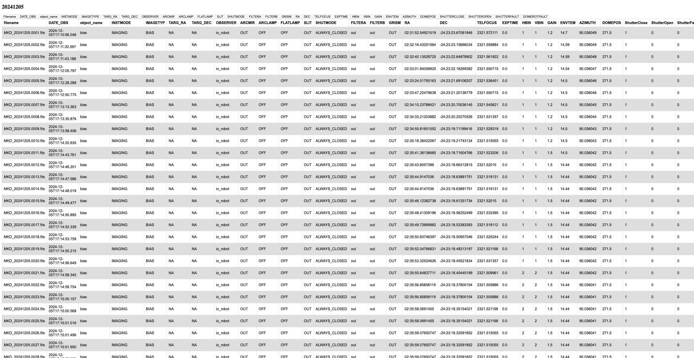
Analysing Observing Logs for Mookodi/Lesedi

Slide 10
Analysing Observing Logs for Mookodi/Lesedi

Slide 11
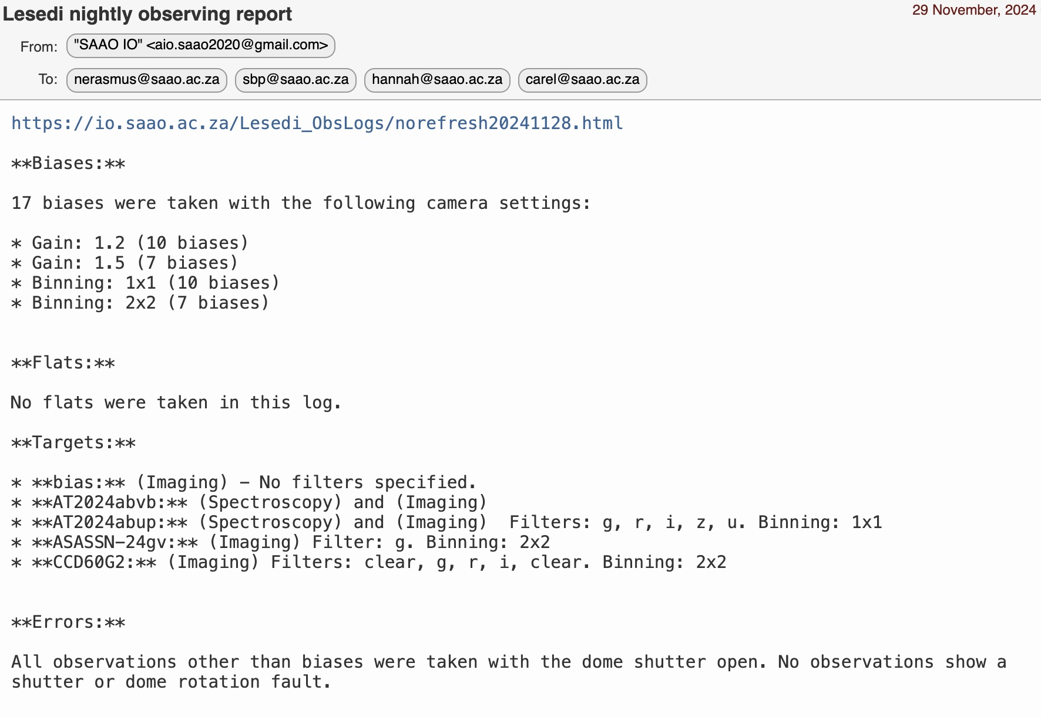
Analysing Observing Logs for Mookodi/Lesedi

Slide 12
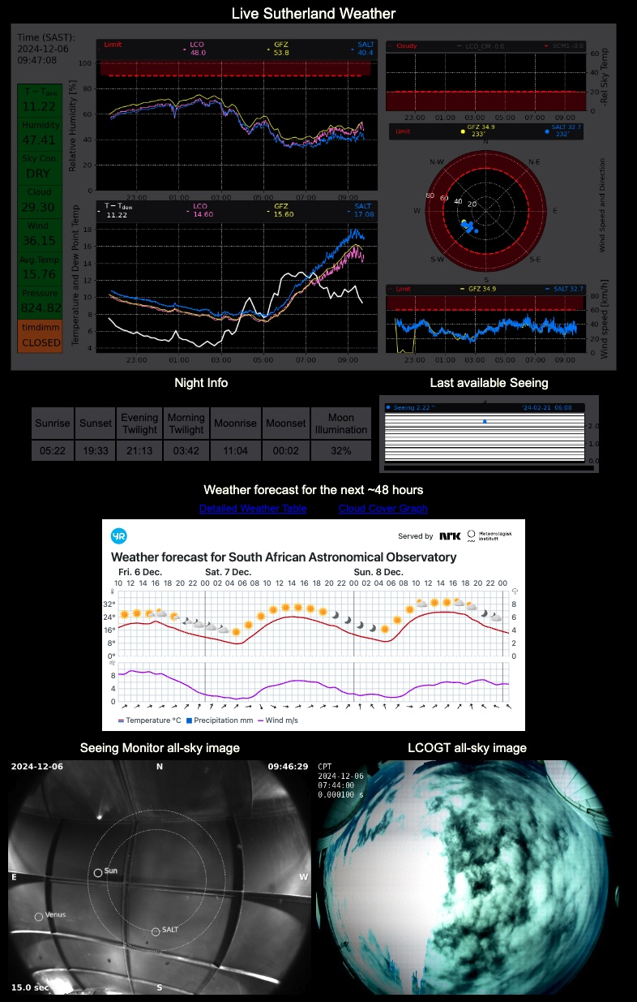
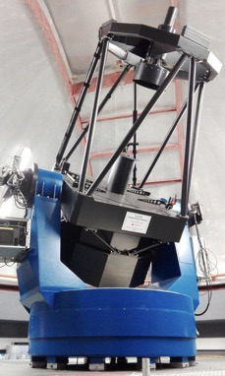
The Alerts Project
A unified system to alert:

Slide 13
The Telemetry Project
A unified system to log and analyse telemetry from all instruments and telescopes:
To perform health-checks
Predict necessary maintenance in advance
Produce advanced data products
Requires:
Logging of telemetry
Database design and implementation
AI tools

Slide 14
Document Configuration Management
SALT docs, SAAO docs, IO docs, Topswiki, googledocs ….

Slide 15
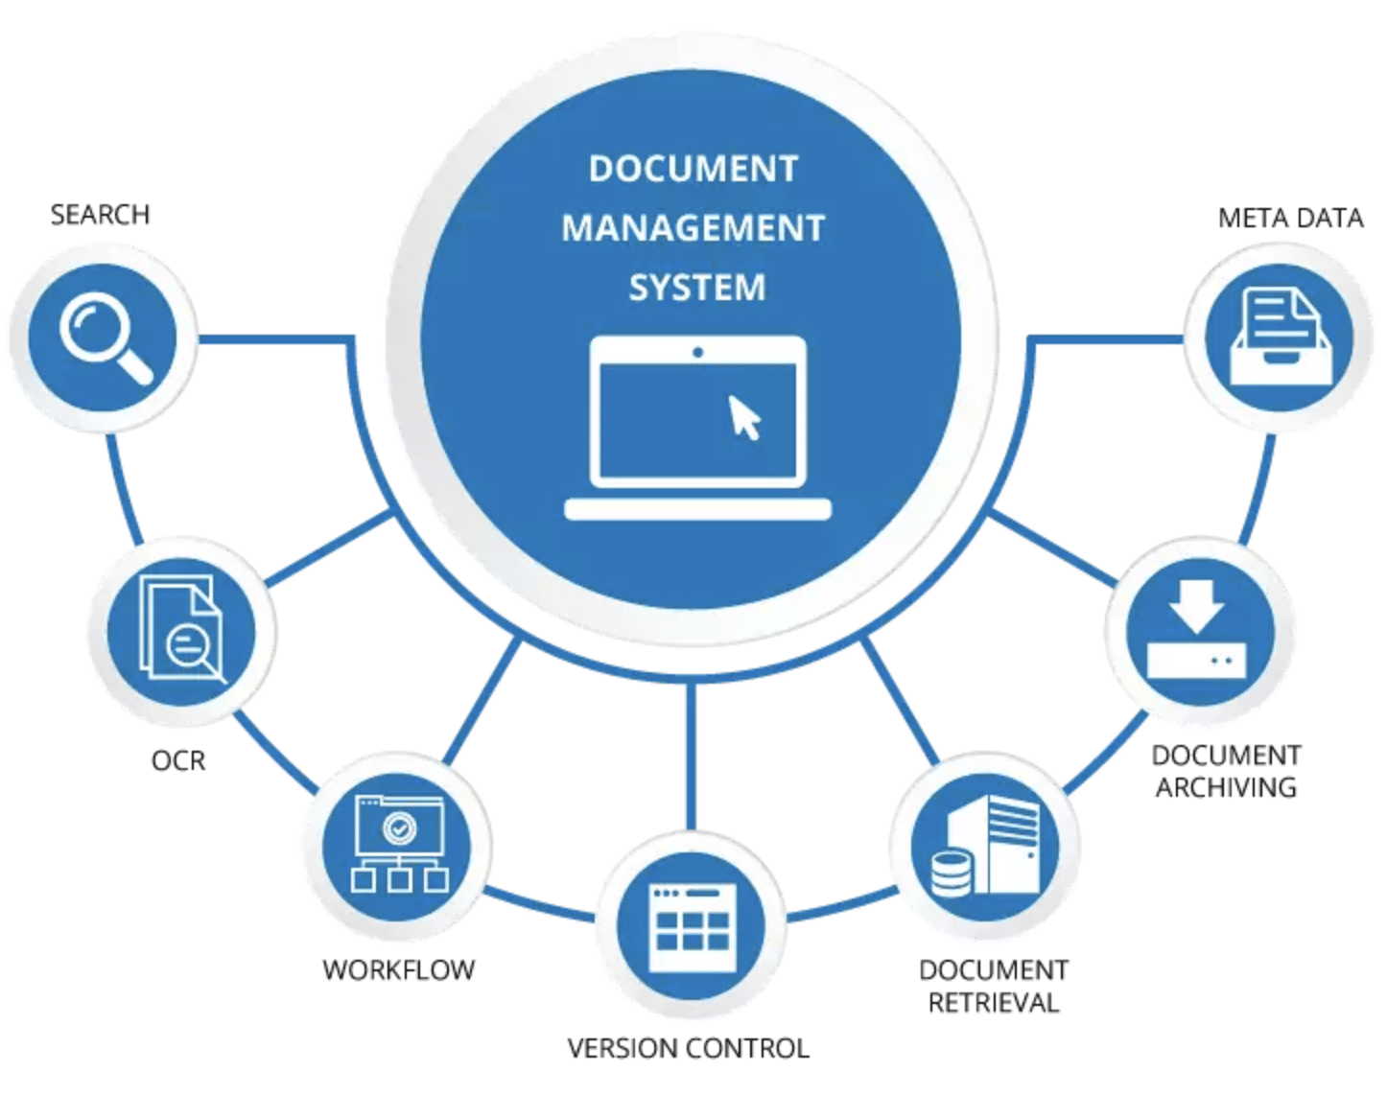

Slide 16
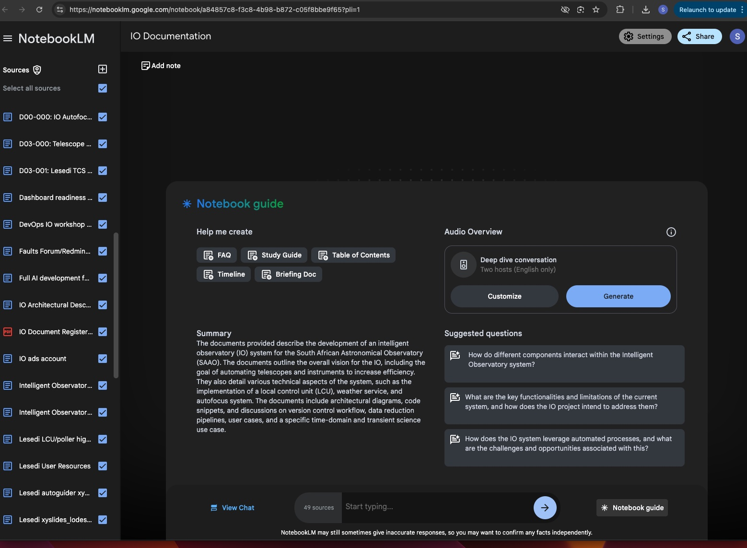

Slide 17
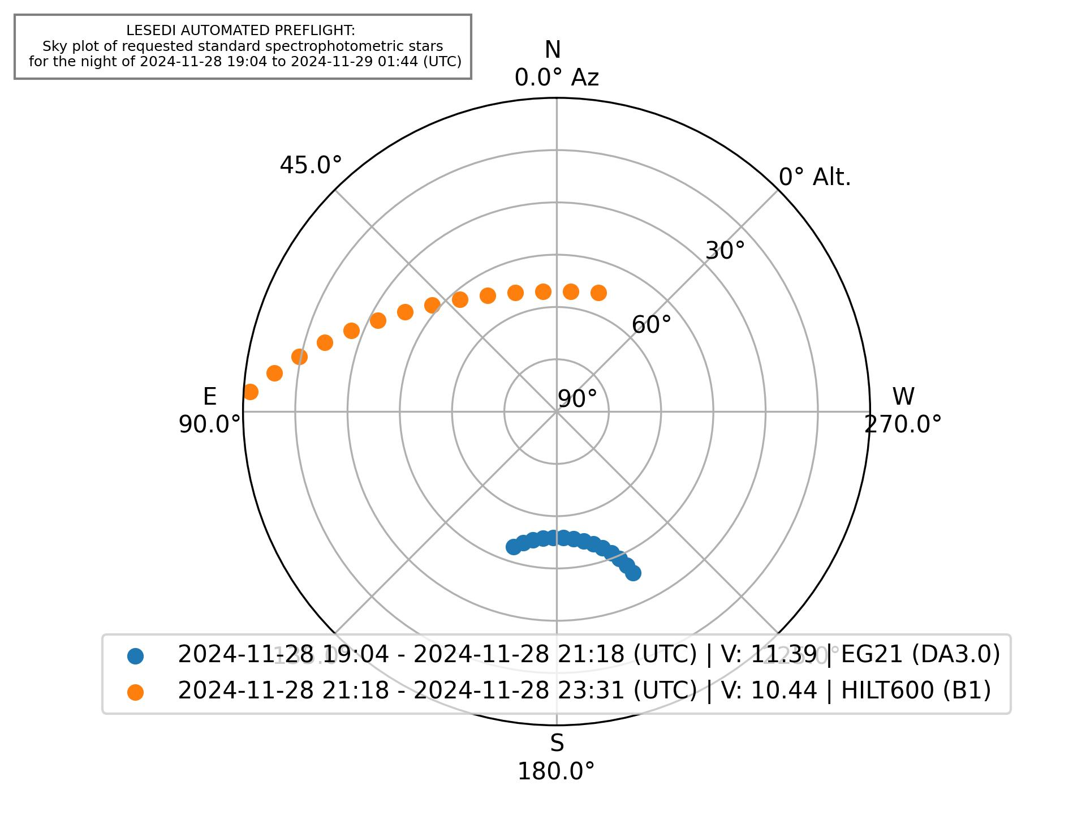
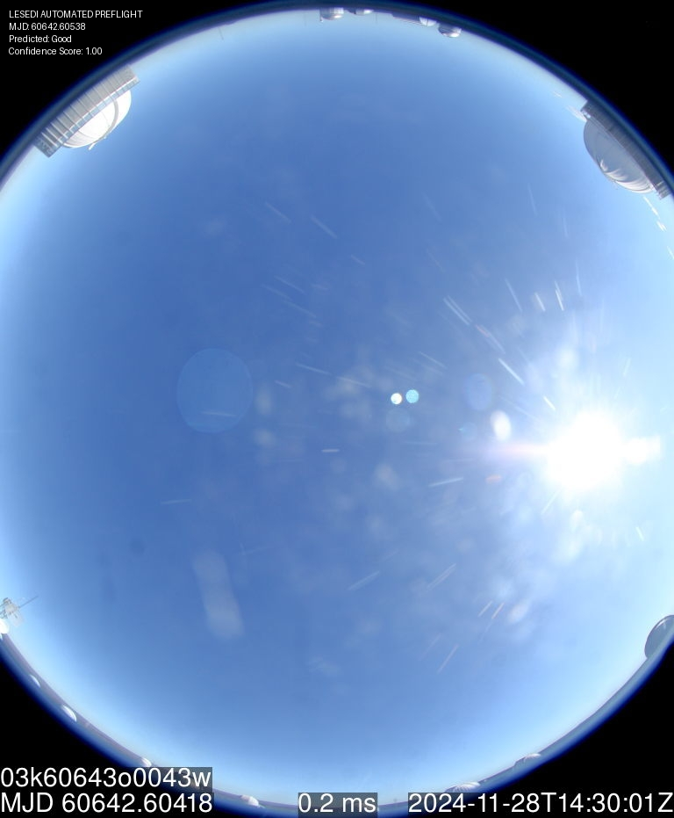
Lesedi Pre-Flight

Slide 18
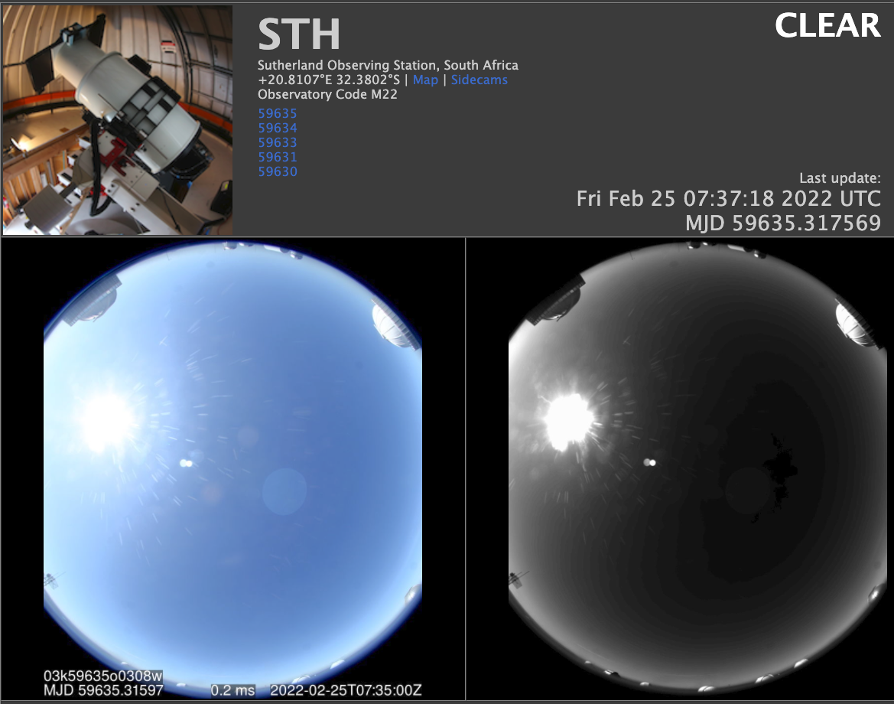
Analysis of ATLAS all-sky DAY images
for scheduling flats with Mookodi

Slide 19
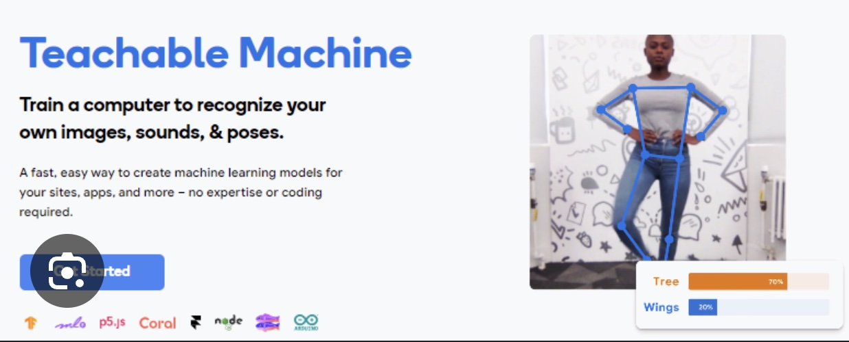
Analysis of ATLAS all-sky DAY images
for scheduling flats with Mookodi
The model is trained on data collected over several months and sorted by cloud cover percentages (GOOD: 0-20%, MARGINAL: 20-40%, BAD: 40-100%).
The model was trained via Google’s Teachable Machines, then implemented in Python using Keras (an open-source deep learning library written in Python).
Image is also verified using computer vision of timestamps embedded within the image).

Slide 20
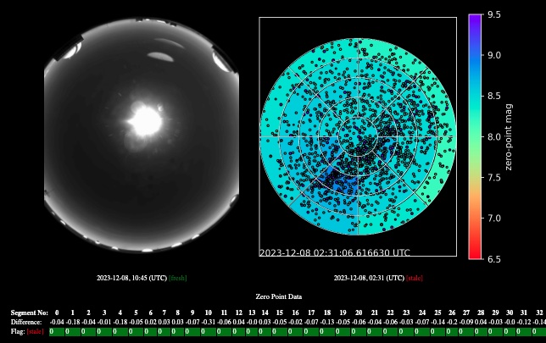
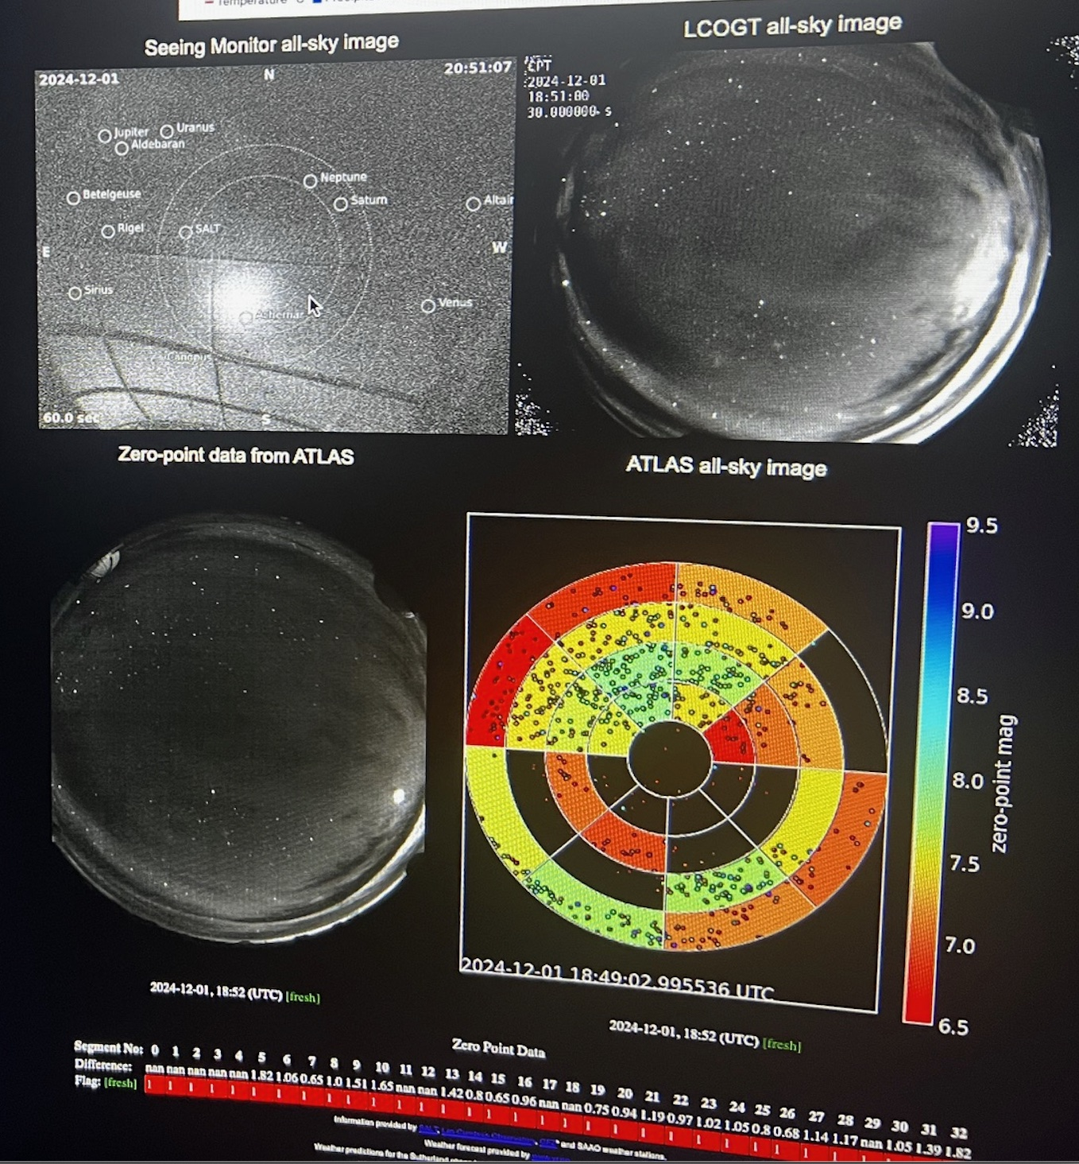
Analysis of ATLAS all-sky NIGHT images
for determining cloud coverage

Slide 21
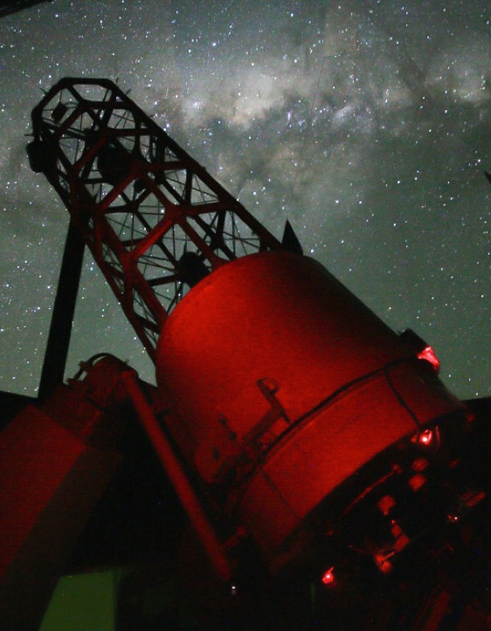
Automation of 74inch+SHOCNWONDER
via the OCS
Testing/fine tuning:
Submit requests via OCS
74inch polls OCS for schedule
74inch executes OCS requests
Point to target RA, Dec
Perform WCS on live image
Fine pointing to magic pixel
Auto focus
Start guiding
Perform observations
Todo:
LCU for weather override etc

Slide 22
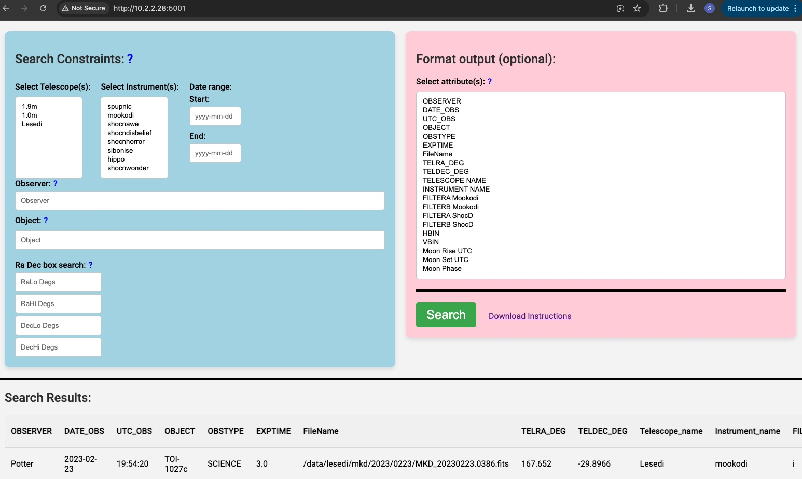
SAAO data archive

